Slide 1
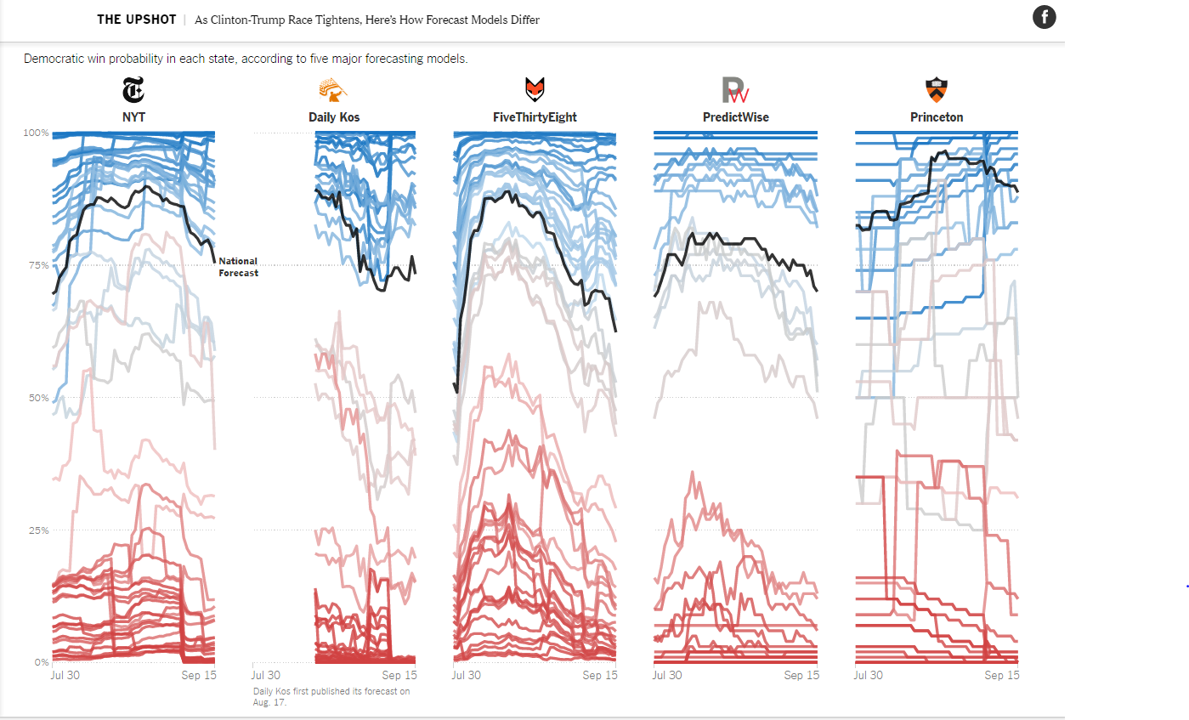
Making sense of the campaign
LESSONS IN NEWS LITERACY
But is it true?
PART 2: POLLS AND THE NATURE OF TRUTH
Notes:
Last week, we began exploring the path from fact to truth by looking at the journalistic process of verification as we fact-checked presidential candidates. But getting our facts straight is only the first step in the journey to truth. Today, we look at how some key News Literacy concepts – context, transparency and provisional truth – combine to complete that journey. And to do that, we look at a component of campaign news that has the capability to both obscure and clarify truth – political polling.

Slide 2
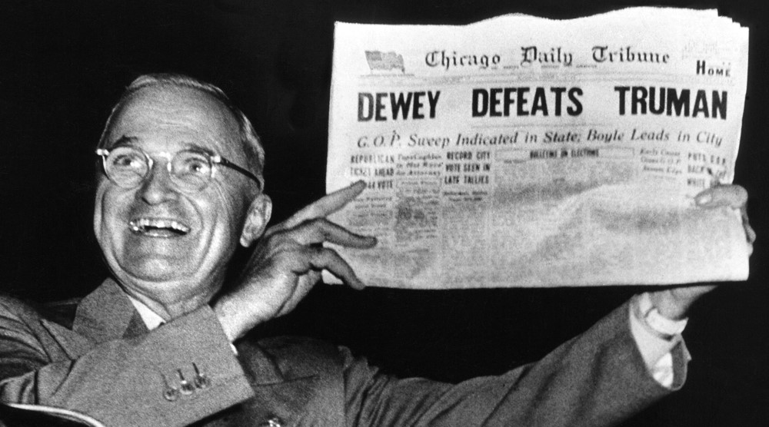
WHAT’S WRONG WITH THIS PICTURE?
Notes:
The picture of a triumphant President Harry Truman posing with a newspaper proclaiming the victory of his 1948 election opponent remains one of the most famous news photos in history for good reason. The huge banner headline was wrong.
Truman’s win had surprised the Chicago Tribune and today, more than a half-century later, stands as a cautionary tale about the nature and limitations of political polling.

Slide 3
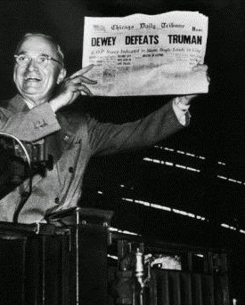
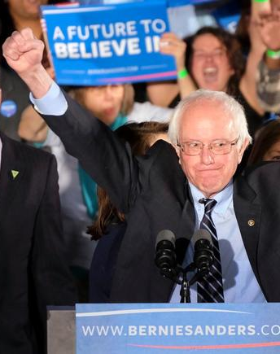
BOTH TAUGHT US SOMETHING ABOUT POLLS
Political polls said Harry Truman and Bernie Sanders were way behind.
Truman surprised all with his 1948 victory. Sanders upset Hillary Clinton in the Michigan Democratic primary in 2016.
1948 RACE FOR PRESIDENT
2016 MICHIGAN DEMOCRATIC PRIMARY
Notes:
Truman had gone to sleep that evening believing he had lost the election to New York Gov. Thomas E. Dewey. The Chicago Tribune’s decision to go ahead with the headline was based on polls, including the well-respected Gallup Poll, which had showed Dewey well out in front of Truman (who had only become president in 1945 upon the death of FDR). In one of the greatest upsets in American political history, Truman won the electoral vote (the only vote that counts) by the substantial margin of 303-189. He won the popular vote by 3 million votes.
Fast forward to March 8, 2016, and as voters go to the polls in the Michigan Democratic Party primary, all the polls say it will be an easy win for Hillary Clinton. A win by Bernie Sanders would be “among the greatest polling errors in primary history,” said Nate Silver, editor and founder of FiveThirtyEight.com, the news data site named after the 538 votes in the Electoral College. And that's just what happened. Sanders upset Clinton with a narrow win no one saw coming.

Slide 4
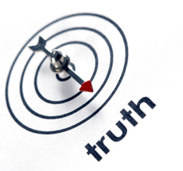
AND SOMETHING ABOUT THE TRUTH
Journalistic truth is provisional – the truth, or at least, our understanding of it, at a specific moment in time. It can change as more information surfaces or circumstances change.
A political poll, at best, is just that – a snapshot in time, subject to change. Polling stopped before a late move by voters to Truman and Sanders.
Notes:
News Literacy teaches us that journalistic truth is provisional — the truth, or at least, our understanding of it, at a specific moment in time. It can change as more information surfaces or circumstances change. A political poll, under the best circumstances, is just that — a snapshot in time, subject to change.
The Gallup organization would later say it had made a mistake in 1948 by stopping its polling the week before Election Day, before a late move to Truman by undecided voters. There were a number of factor, including poling models that underestimated the turnout of young Sanders supporters and independents. But one factor cited by polling analysts hearkened back to Harry Truman's upset win more than a half-century earlier. "Pollsters missed a late break to Sanders by not polling after Sunday," reported Five ThirtyEight. "Clinton and Sanders debated in Flint on Sunday and met in a town hall in Detroit on Monday. No public pollsters contacted voters after either event."
It was a reminder that political polls can only tell us something about a moment in the past, not the future.

Slide 5
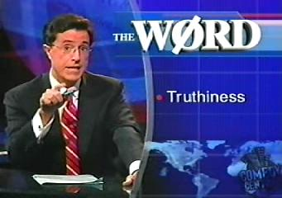
What is truth?
“Truthiness”*
* “The quality of stating concepts or facts one wishes or believes to be true, rather than concepts or facts known to be true.”
― THE AMERICAN DIALECT SOCIETY
Notes:
So, before we take a deeper dive into the truth about polling, let’s take a moment to consider our understanding of Truth (with a capital T). Scientists and philosophers began exploring the topic long centuries ago.
Let’s start with something a little more recent. On the October 17, 2005 pilot episode of The Colbert Report, he coined the word that would become Merriam Webster’s 2006 Word of the year: “Truthiness. “

Slide 6
Truthiness.wmv
Notes:
VIDEO BEGINS AUTOMATICALLY
“Truth that comes from the gut, not from books.”
Colbert used it to skewer Wikipedia, the 2003 decision to invade Iraq and President Bush’s defense of his nomination of Harriet Miers to the Supreme Court.
The American Dialect Society says in conversational use, “Truthiness” is the quality of stating concepts or facts one wishes or believes to be true, rather than concepts or facts known to be true.”

Slide 7
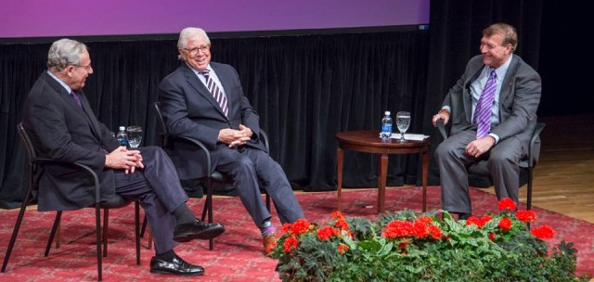
What is journalism’s goal?
“…the best obtainable version of the truth.”
Bob Woodward
and Carl Bernstein at Stony Brook University
on Oct. 16, 2014
Notes:
Journalists looked for a more practical and less subjective definition as their pursuit of truth came to resemble the piecing together of a jigsaw puzzle, where each piece either clarified or changed their perception of a truth that might not be entirely clear until historians took a look back sometime in the future – and even then might be the subject of debate.
Bob Woodward and Carl Bernstein, the famous Watergate investigative reporters took a pragmatic view. Journalistic truth, they said when speaking at Stony Brook University, is “the best obtainable version of the truth” at that moment.

Slide 8
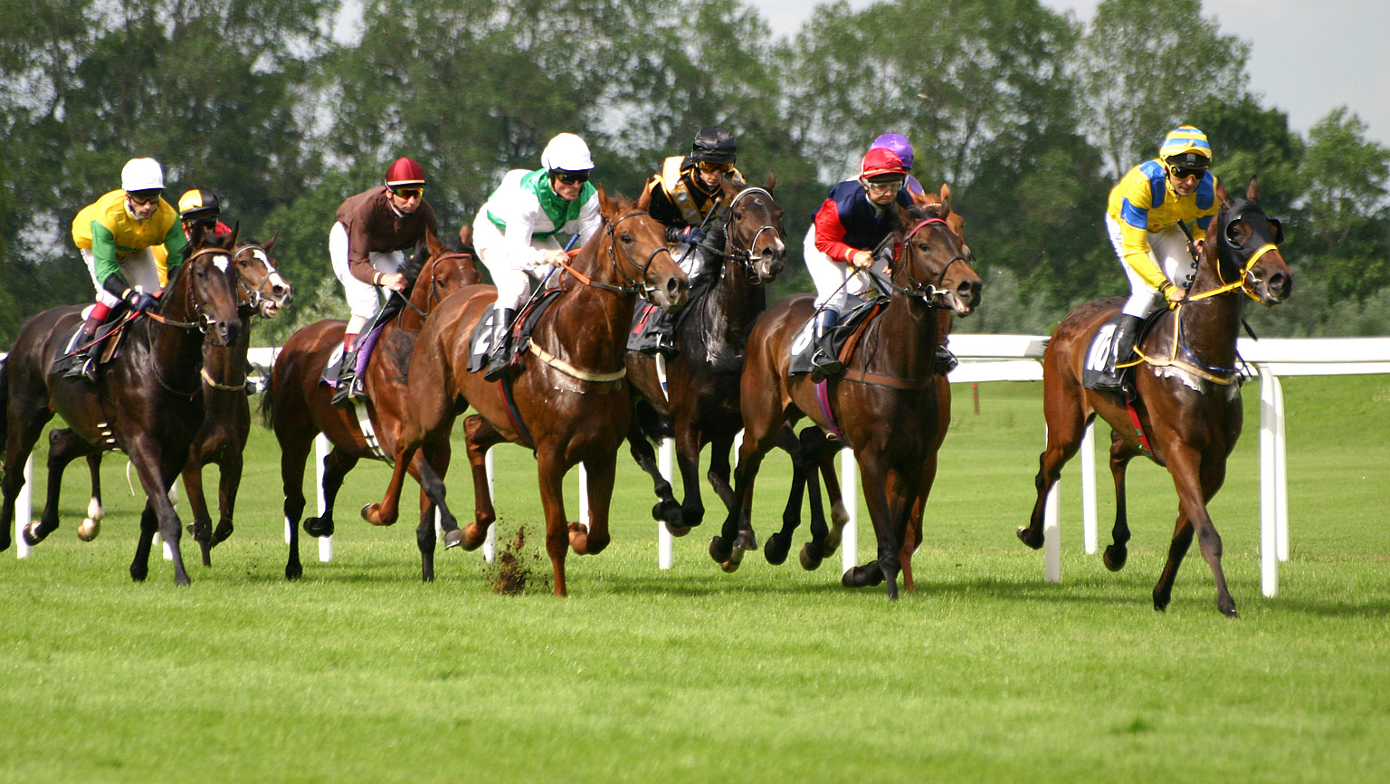
Over the past year, “horse race coverage” has dominated campaign journalism
Notes:
And “at that moment” is the modifier chiefly at play in the reporting about a political campaign that has predominantly been characterized as “horse race coverage.” Far more ink, pageviews and air time have been devoted to how the candidates are doing in the polls and their strategies for victory than on their qualifications and where they stand on the issues.
In other words, polling has become a key part of the discussion, and that includes among the candidates themselves.

Slide 9
Notes:
POLLING DISCUSSION VIDEO BEGINS AUTOMATICALLY

Slide 10
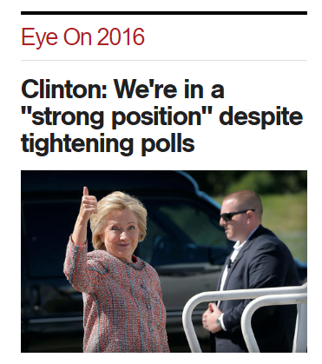
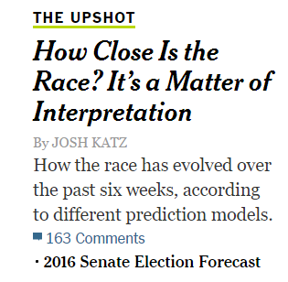
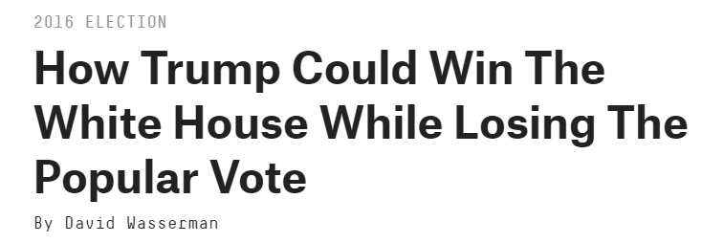
THE
TRUTHABOUT POLLS
Notes:
Though the cautionary tale of Harry Truman’s surprise election remains relevant, the introduction of a 24-hour news cycle, social media and a proliferation of pollsters have only increased the volatility of the electorate and the need to view poll results critically.

Slide 11
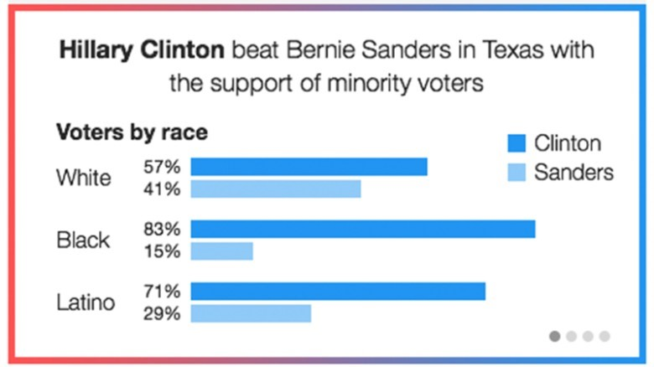
1. TIMING IS EVERYTHING
The closer we are to voting, the more reliable the poll. Public opinion is volatile. No truth is more provisional than political poll results.
Exit polls can be the most valuable. Polls taken right after voters cast their ballots can show not only who is winning but why.
Notes:
“Even within a week of a primary election, the polls are often inaccurate,” Harry Enten says in “Harry’s Guide to 2016 Election Polls.” Enten is senior political writer and analyst for FiveThirtyEight. The lesson? The farther away you are from voters casting ballots, the less reliable the poll.
The most valuable polling information, not surprisingly, often comes from exit polls taken on Election Day.
Super Tuesday exit polls not only told us who was winning before all the votes were in, they offered insight into why they were winning. It wasn’t surprising that Hillary Clinton did better than Bernie Sanders among nonwhite voters, but only exit polls could tell us how much better she did.

Slide 12
The best advice for consumers? Watch the polls over time. Provisional truth puts the burden on the news consumer to stay with the story as our understanding of the truth changes.
FOLLOW THE STORY OVER TIME
Notes:
ANIMATION: Typewriter effect adds the key message: Follow the story over time.
So with the release of every new horse race poll, remember the concept of provisional truth and the best advice for news consumers encountering it — follow the story over time. Watching polls over time can tell you which candidates are growing in strength and which ones may be fading. Remember, too, that no truth may be more provisional than efforts to measure public opinion.

Slide 13
2. IS THE POLL REALLY A POLL?
A poll employs a statistical methodology. A simple survey does not. There is no such thing as an “unscientific” or “informal” poll.
What is a poll?
An unbiased, scientific opinion poll uses trained interviewers to ask carefully worded questions of a particular random but representative sample that can reveal the preferences or beliefs of a given population.
If the poll is not conducted by an independent outfit, or the sample is not randomly chosen or representative, the results have no statistical significance.
Notes:
The concept of provisional truth, of course, only enters into the equation if what you are evaluating is actually a poll. The terms “poll” and “survey” are often used interchangeably, but the distinction is important. A poll employs a statistical methodology. A simple survey does not. There is no such thing as an “unscientific” or “informal” poll.
To be precise, an unbiased, scientific opinion poll uses trained interviewers to ask carefully worded questions of a particular random but representative sample that can reveal the preferences or beliefs of a given population. If a TV reporter interviews 10 randomly selected pedestrians to see which candidate each supports, the sample is far too small to be considered statistically representative. If a news website asks readers to vote in an Internet poll, the sampling can’t be random because the respondents selected themselves.

Slide 14
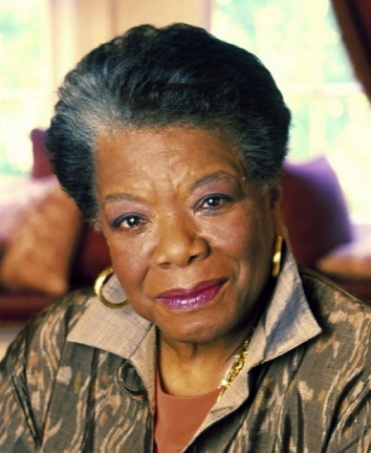
“There's a world of difference between truth and facts. Facts can obscure the truth.”
− MAYA ANGELOU
NOT JUST THE FACTS
For news consumers trying to put political poll results in perspective, the journey from fact to truth relies on two more News Literacy concepts – context and transparency.
Notes:
Poll results are, essentially, raw information that requires context and transparent reporting to arrive at the truth.
And as poet Maya Angelou noted, not only are facts and truth not the same thing – facts taken out of context can distort our understanding of the truth.

Slide 15
CONTEXT
Facts about who was polled and how can put findings in perspective and help us understand their meaning and significance
Notes:
Remember context?
Although they often are, raw poll results cannot be taken out of context. To put the numbers in perspective, news consumers should not only ask when the poll was taken, but also who answered and asked the questions and what the other polls are saying.

Slide 16
TRANSPARENCY
News reports about political polling results should always tell you about the methodology that was used, including the margin of error.
Notes:
News Literacy teaches us that transparency occurs when journalists are honest about what they know, how they know it and what they don’t know. When reading a news story, there are two ways we see that:
1. Specifying in a story what you do not know or could not learn. For example: “It could not be learned… He or she could not be reached for comment.”
2. Specifying how the reporter got the information. For example: “In an interview at his front door, the suspect said…According to documents obtained by Channel 6 News…”
In the world of political polling, transparency best served when a report tells news consumers how the poll was conducted and unfailingly reports whether the results fell within the margin of error.

Slide 17
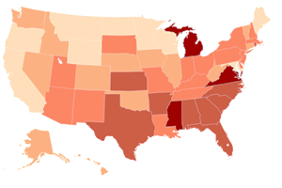
3. WHO WAS POLLED?
National polls tell us very little about state-by-state contests . The race for a party’s presidential nomination is won by capturing delegates in statewide primaries and caucuses. The presidency is won in state-by-state voting as well.
Are the poll respondents “likely” voters? Polls that talk with “registered voters” aren’t as reliable as polls that talk to “likely” voters.
Notes:
One of the most important questions a news consumer can ask when evaluating a report is: “Says who?” The more authoritative and trustworthy the source, the more credible the report. When it comes to political polling, that means first determining who the pollsters surveyed. A primary season CNN/ORC poll that concluded both Clinton and Sanders would beat Trump if the election were held that day was based on nationwide interviews of registered voters. What’s the problem? There are two, actually.
First, the poll surveyed a national audience. The primaries are state-by-state contests. There is no national vote for the Republican Party nomination or, for that matter, the presidency, where Americans cast ballots to determine each state's Electoral College votes. National poll results can be interesting, but that’s about it.
Second, the best polls survey likely voters, not just registered voters. The most accurate polls talk to the people who will be voting, not the ones who are eligible to vote but may stay home.

Slide 18
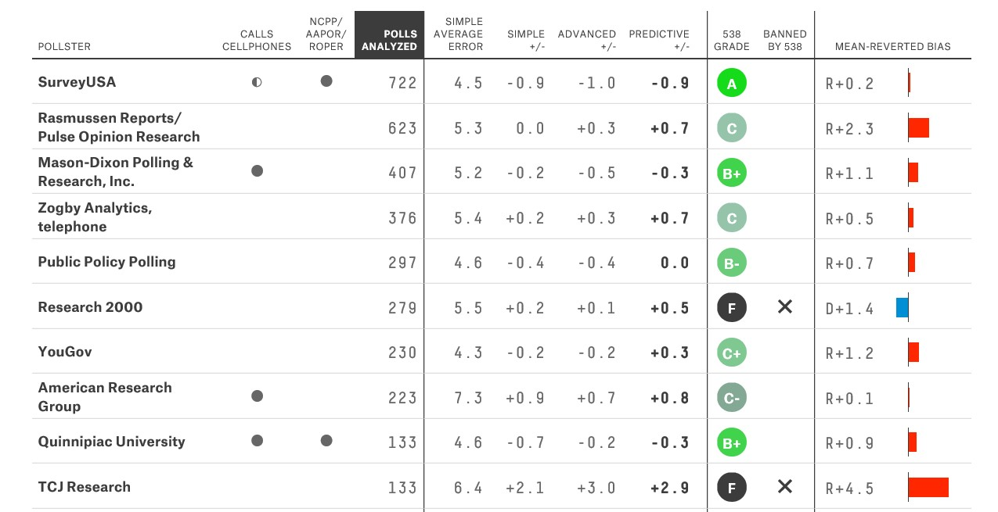
4. WHO DID THE POLLING?
Polling organizations are not all equal. Independent pollsters with a strong track record are the most reliable.
The website FiveThirtyEight.com tracks and rates pollsters.
Notes:
Who is asking the questions can be as important as who is answering them. Independent polling organizations with a strong track record are the most reliable. “Polls sponsored by major news organizations (ABC News, NBC News, The New York Times, etc.) are often the most accurate because more money is spent on them,” 538’s Harry Enten says. “If you haven’t heard of a pollster before, there’s probably a good reason for it. If you’re in doubt, check the FiveThirtyEight Pollster Ratings.” CNN/Opinion Research Corp., for example, got a respectable A-minus from Five ThirtyEight.com.

Slide 19
5. WHAT ARE OTHER POLLS SAYING?
Polls whose findings are consistent with others are more reliable. Analysts who calculate polling averages have the best track record.
FiveThirtyEight.com
Notes:
Perhaps the most important way to put results of an individual poll into perspective is to view it in the context of what other polls are saying. Like witnesses in a trial, when multiple polls are telling the same story, it gains credibility. When different organizations are getting wildly different results, caution is in order. And when one poll makes headlines because it is showing something none of the others do, it’s an “outlier” — something news consumers should look at skeptically. Outliers tend to get a lot of attention, but they’re often outliers for a reason – they’re wrong.
Led by FiveThirtyEight.com’s Nate Silver, analysts are comparing, contrasting and aggregating all the different polls. Using this approach, Silver in particular has been uncannily accurate in interpreting the polls.

Slide 20
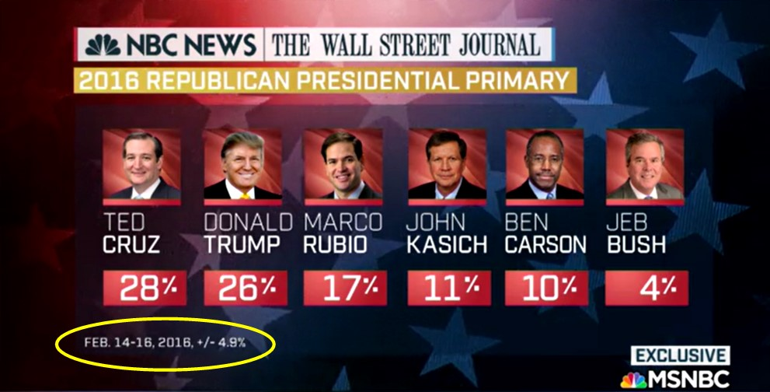
6. WHAT IS THE MARGIN OF ERROR?
Who won this poll? It was too close to call. Always compare the margin of victory with the margin of error.
The margin of error is a calculation based on the sample size in relation to the overall population. In this case, each result may be roughly 5 percentage points higher or lower.
Notes:
The margin of error is a calculation based on the sample size in relation to the overall population. Here’s how the Gallup organization explains it: “If the results of a scientific poll claiming a 3-point margin of error say that 30% of Americans like ice cream, this means that if we asked all Americans this question, we would expect between 27% and 33% to say they like ice cream.”
Donald Trump and Ted Cruz were separated by two percentage points in this NBC/Wall Street Journal poll, which had a margin of error of 4.9 percentage points. So, statistically, it was too close to call.

Slide 21
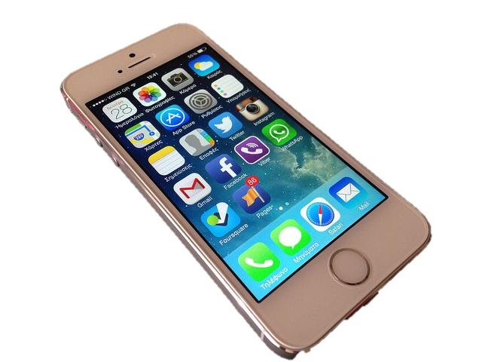
7. HOW WAS THE POLL CONDUCTED?
Wrong number? The most reliable method of polling employs telephone interviews, but that has gotten much harder in recent years as mobile phones replace land lines around the country – especially among younger voters.
Time for a few questions? Older, retired people are more likely to take the time to answer pollsters’ questions.
Polling has become as much art as science as pollsters develop models and statistical assumptions to compensate.
Notes:
The most reliable method of polling employs telephone interviews, but that has gotten much harder in recent years. The digital age shifts from landlines to mobile phones has reduced the pool of prospective respondents, as has the public’s attitude toward talking with pollsters. Fifty years ago, pollsters found the 90 percent of people they reached by phone would agree to partake in the poll. Now it is below 10 percent, and pollsters find themselves having to adjust for the reality that these respondents are disproportionately older and more conservative.
As a result, political polling has evolved to a point where it as much an art as it is a science. That’s particularly true when comes to predicting which groups will vote in what numbers. This determination can significantly affect the poll’s accuracy.

Slide 22
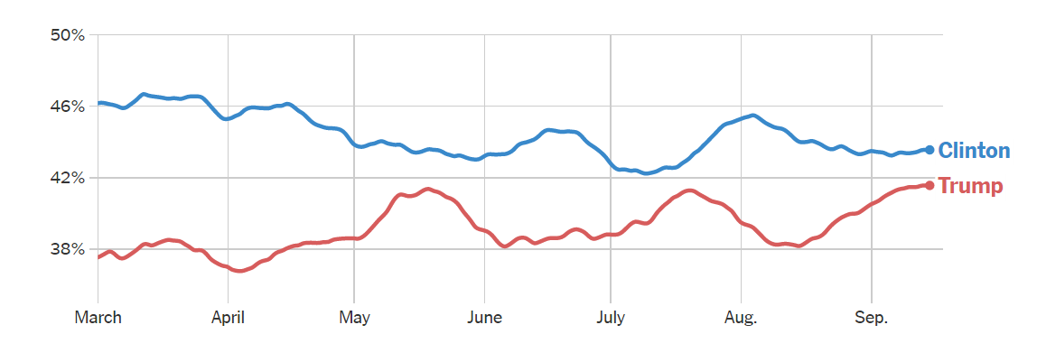
8. FOLLOW THE STORY OVER TIME
Notes:
Which brings us back Harry Truman and one of the key takeaways from this lesson: Results of an individual political poll represents, at best, a snapshot in time – the truth at that particular moment. And while the results of a series of polls taken over time can show a trend in public opinion, the most we can reliably take away from them is an understanding of where we’ve been and where things stand today. Not what the truth will be tomorrow – even if the pollsters ask what respondents would do if the election were today. Well, the truth is that it’s not today. It’s on Nov. 8, when the only polls that truly count will be conducted.

Slide 23
The truth won’t stand still
Notes:
Of course, news producers and news consumers can’t wait around until all the facts are in – until the truth stands still. There is a great hunger for news about the election and so much else, and even in the digital age, with real-time bulletins and updates, the best journalism can offer is a snapshot in time – the best available truth at that moment.
So let’s take a step back and look at how these News Literacy lessons and concepts apply to how the news is produced and what you, as news consumers, should know about that.

Slide 24
So why not wait for the real truth?
Notes:
But surely, some of you must be wondering, instead of getting stories wrong, why doesn’t the news media just wait for the real truth?

Slide 25
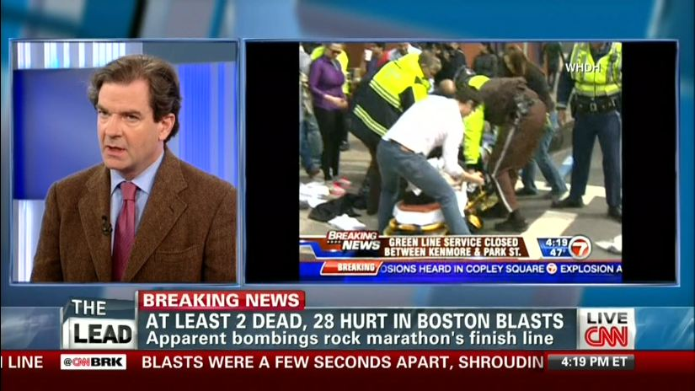
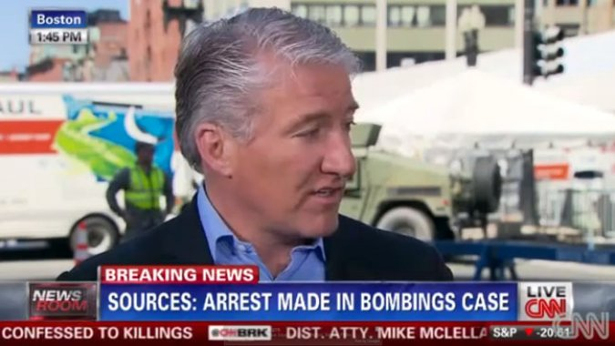
Sometimes, editors do wait.
Sometimes, they can’t.
Sometimes, they wish they had.
Notes:
Sometimes, when a dramatic story begins to unfold before our eyes, people turn on their TVs or check social media or websites and want to find out – no, expect to find out – what’s happening. Even if reporters on the scene know very little.
It’s an especially dangerous time because the pressure to provide information fast – and, first – sometimes causes reporters to get ahead of the facts.
Journalism – good journalism – requires time for the process of verification (a topic we will explore in depth next week).
It’s Boston, the day of the bloody Boston Marathon bomibing. At 1:45 p.m., while the Tsarnov brothers were still at large, CNN’s John King went on the air to report that his sources had told him an arrest had been made. Others, including the Associated Press, were reporting the same thing. Well, the sources had been mistaken. The truth was that no arrests had yet been made, and that would be clear soon after.

Slide 26
Truth tests
Just as scientists can test a material’s properties, news consumers can assess the reliability of a report.
Here are some key concepts we’ll explore in greater detail later in the course.
Notes:
A note from your friendly neighborhood News Lit navigator:
As we mentioned during the first lecture, the first part of the course introduces key concepts that later on will be the basis for specific techniques for evaluating news sources and stories. Techniques you will put to use in the final exam and, hopefully, take away with you and use for years to come.

Slide 27
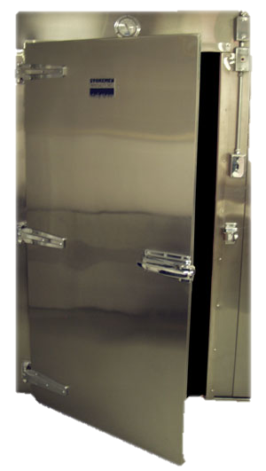
TRUTH TESTS 1. Says who?
2. Are the facts in context?
3. Is the report transparent?
4. Did they open the freezer?
Notes:
Here’s something of a preview as we look at four of these key concepts and give you a sense, though a series of “Truth Tests,” of how they will help you answer the question – But, is it true?

Slide 28
TRUTH TESTS 1. Says who?
A news report is only as reliable as the evidence it presents. Look for evidence, and ask where it comes from.
The source of that evidence
determines the weight you give it.
Notes:
Sources provide evidence, but we evaluate the reliability of sources.
We determine the strength/weight of evidence.
And nothing tells you more about how much weight to give evidence than the reliability of the source who provided it.

Slide 29
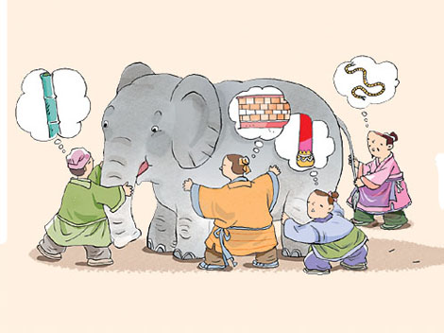
Partial evidence, different ‘truths’
The truth is most likely to emerge when news stories include a variety of perspectives.
Notes:
What about the classic tale of the blind men and the elephant? They compare what they feel and cannot agree what it is.
It is notable that the moral of this story is not that the truth is relative. No matter how many perspectives and theories there may be on what an elephant is, there is a real elephant, and that elephant is a certain way independent of the blind men’s theories.
The point is that sometimes all we have are those disparate observations based on individuals’ point of view. Seeking the truth means not only presenting all relevant perspectives but also analyzing them to see where they agree and disagree – what do we know about the elephant and what is uncertain? That’s the best available truth.

Slide 30
Questions to think about
Who is providing this information?
How would this person know about this?
Is anyone else telling the same story?
Does this person have a reason to withhold information or mislead us?
Are we getting facts or just opinions?
Notes:
ANIMATION: EACH QUESTION COMES UP WITH A CLICK
We have an entire lecture later this semester that will explore techniques for evaluating sources, but in the meantime, as you read or watch news stories, think about these questions.

Slide 31
TRUTH TESTS 2. Are the facts put in context?
Notes:
Viewing individual facts in context is making sure you see the whole picture as you try to understand the overall truth.

Slide 32
THE POWER OF CONTEXT
Notes:
Animation: Click1=Photo, Click2= Headline, Click3= Excerpt
Click - You see a photo of a toddler chained to a tree. What do you think?
Click
Now what do you think?
Click:Reporter Tania Branigan in Beijing interviews the father, who says his daughter was abducted, so while he must work, he chains up the boy, Jingdan.
that change how you see the photo? That is context, what you might call “The Rest of the Story.”
As a news consumer, if you don’t look for context, you can miss the story.
http://www.dailymail.co.uk/news/article-1248252/Chinese-boy-chained-lamp-post-dad.html

Slide 33
TRUTH TESTS 3. Is the report transparent?
Notes:
Transparency in polling reveals the circumstances, assumptions and limitations readers should take into account when evaluating the results.
Good journalists are no less upfront and honest about the reports they put together for you.

Slide 34
TRANSPARENCY
In a news story, it is present when reporters are open and honest about . . .
How they know what they know
What they don’t know – and why
Notes:
When ordinary news consumers finish reading or watching a news story, they might ask themselves what they just learned.
Critically thinking news consumers don’t just ask themselves “what do I know?”
They ask, “How do I know it?” and “What don’t I know?”
The best news stories answer those questions. And they do it by being transparent about the newsgathering process.

Slide 35
TRUTH TESTS 4. Did they open the freezer?
A decade ago, in the aftermath of Hurricane Katrina in New Orleans, a mistake that would haunt a reporter for years to come provides a cautionary tale for News Literacy students.
Notes:
It’s worth remembering at this moment the cautionary tale from the aftermath of Hurricane Katrina that we shared last week about the importance of direct evidence. Always invoke the News Literacy metaphor by asking yourself if the reporter “opened the freezer” – verified the truth with direct evidence, not just the say-so of others.

Slide 36
There is a hierarchy of
DIRECT EVIDENCE
VIDEO, AUDIO AND PHOTOS
DOCUMENTS AND RECORDS
JOURNALIST EYEWITNESS ACCOUNT
OBSERVER EYEWITNESS ACCOUNT
Notes:
The key to this verification process is first determining if a statement can be verified, ideally by direct evidence — eyewitness testimony, physical evidence like a fingerprint or DNA, a document, photo, audio or video recording that establishes a fact. Public statements by candidates become part of the public record and can frequently be verified by video or audio recordings. On their own, videos and photographs are stronger evidence that documentary evidence. The eyewitness account from a journalist is stronger than the eyewitness account from a citizen.

Slide 37
Notes:
Time to put all you’ve learned today to work. In general, TV news more than any other medium, is the place to be for stories with great video, dramatic stories unfolding before our eyes. Stories involving numbers and any level of complexity, stories that demand context and transparency, are not its strength. And yet, for so many consumers, TV is their primary news medium.
Let’s watch this report from a local cable TV news station on Long Island about the results of a political poll. Think about what’s you’ve learned about polls, about context, transparency and provisional truth as you watch and take some notes.
((CLICK STARTS VIDEO))

Slide 38
WHAT DID YOU LEARN?
Did the reporter put the poll results in context?
Was the reporter transparent about who was polled, how and when?
What do we know – and how?
What don’t we know?
Notes:
No. Like the TV reporter, the pollsters talked with Long Islanders, the primary audience for both Newsday and News 12. The report did not point out Long Islanders represented less than 2 million of the 11.7 million New York state voters registered in November 2015. Like the national polling results, these were more interesting than important.
The TV report didn’t tell you if the poll talked to registered or likely voters or when it was conducted.
We know the polling was done by two news organizations in conjunction with Sienna College, so it was certainly independent. And the graphic included the margin of error, which was particularly important in the hypothetical Trump vs. Clinton matchup. The three-point difference separating the candidates within the poll’s margin of error of plus or minus 3.1 percentage points. But the reporter never pointed that out.
The TV report provided very little information about the poll, beyond the major results. It did make us hungry. And what about the other kid who got no ice cream cone?

Slide 39
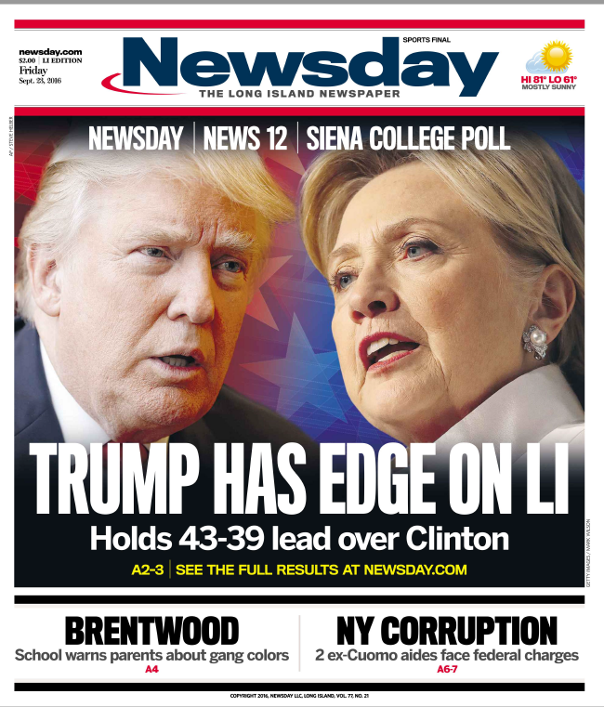
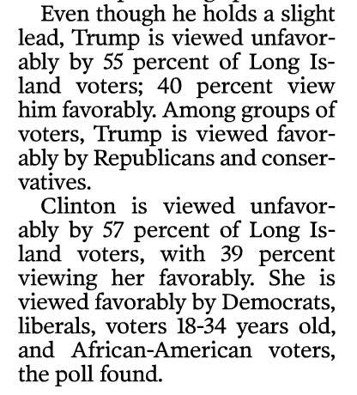
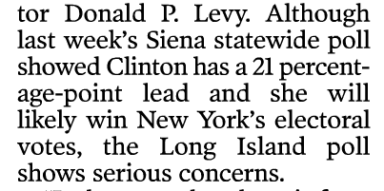
A NEW POLL
Notes:
<<CLICK BRINGS IN MORE FINDINGS>>
That initial Long Island poll was taken in February, before either candidate had locked up the nomination. The results of a follow-up poll, designed to take a snapshot of public opinion on the eve of the first debate, which is being hosted by Hofstra, a Long Island university, showed similar results. What’s different about the two reports is what news consumers learn about poll results on TV and what you find out reading about them in print or online. You get context and greater transparency – and that takes you closer to the truth.

Slide 40
THE TAKEAWAY
Truth is provisional. At best, a poll is a snap shot in time, not an accurate predictor of the outcome. Perhaps nothing is more provisional than public opinion.
“Facts,” in this case the numbers from a political poll, don’t necessarily equate with truth. To determine the value of a poll, consumers need to search for context and ask critical questions. It is easy to be misled.
Remember the importance of context – the information needed to put facts into perspective. When was the poll taken, who were the respondents and how were they chosen. Are other polls coming up with similar findings?
Be aware of how transparent the poll is in reporting the “margin of error” and the methodology used to get the results.

Slide 41
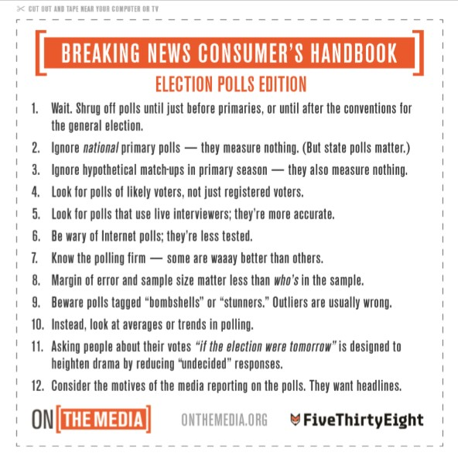
TIPS FROM ‘ON THE MEDIA’
Notes:
A number of these takeaways are echoed in a series of two Breaking News Consumer’s Handbooks produced by the NPR radio program, “On the Media,” which in collaboration with FiveThirtyEight continues to offer insight on polls and coverage of the race.
<<CLICK>> One worth noting that we may not have covered is this idea of asking people “if the election were held today” to factor out undecided voters. The reality is that the election is not today and undecided voters could break either way and affect the outcome.

Slide 42
TIPS FROM ‘ON THE MEDIA’
Notes:
“On the Media” returned recently with an update, mostly cautioning against reading too much into momentary swings in the polls.
<<CLICK>>
And their last point underscored one of this lecture’s primary takeaways with two words – “Stuff happens.” A lesson Harry Truman and Tom Dewey illustrated for us a very long time ago.

Slide 43
WHAT’S WRONG WITH THIS PICTURE?
Notes:
By the way … there’s something else wrong with this picture …
The famous photograph was actually taken by W. Eugene Smith two days after the election as President Harry Truman was taking a train back from his home in Independence, Missouri and they had stopped in St. Louis where an aide gave the president the paper with the incorrect headline.

Slide 44
WHAT DO YOU THINK?
Do you think poll results have taken on too large a role in the 2016 presidential campaign?
Your phone rings. Caller ID says it’s the Gallup organization. Would you take the call and answer its polling questions? Would the answer be any different if the pollster said he was working for a specific campaign?
Notes:
IF TIME ALLOWS, SOME DISCUSSION QUESTIONS

Slide 45
The Quick Quiz
What is context?
If a news report is transparent, the reader or viewer learns what?
Write a question we can answer to clarify today’s lesson … or a comment that will help us improve our work.
HAND THE ANSWERS TO YOUR RECITATION INSTRUCTOR

